Slide 1
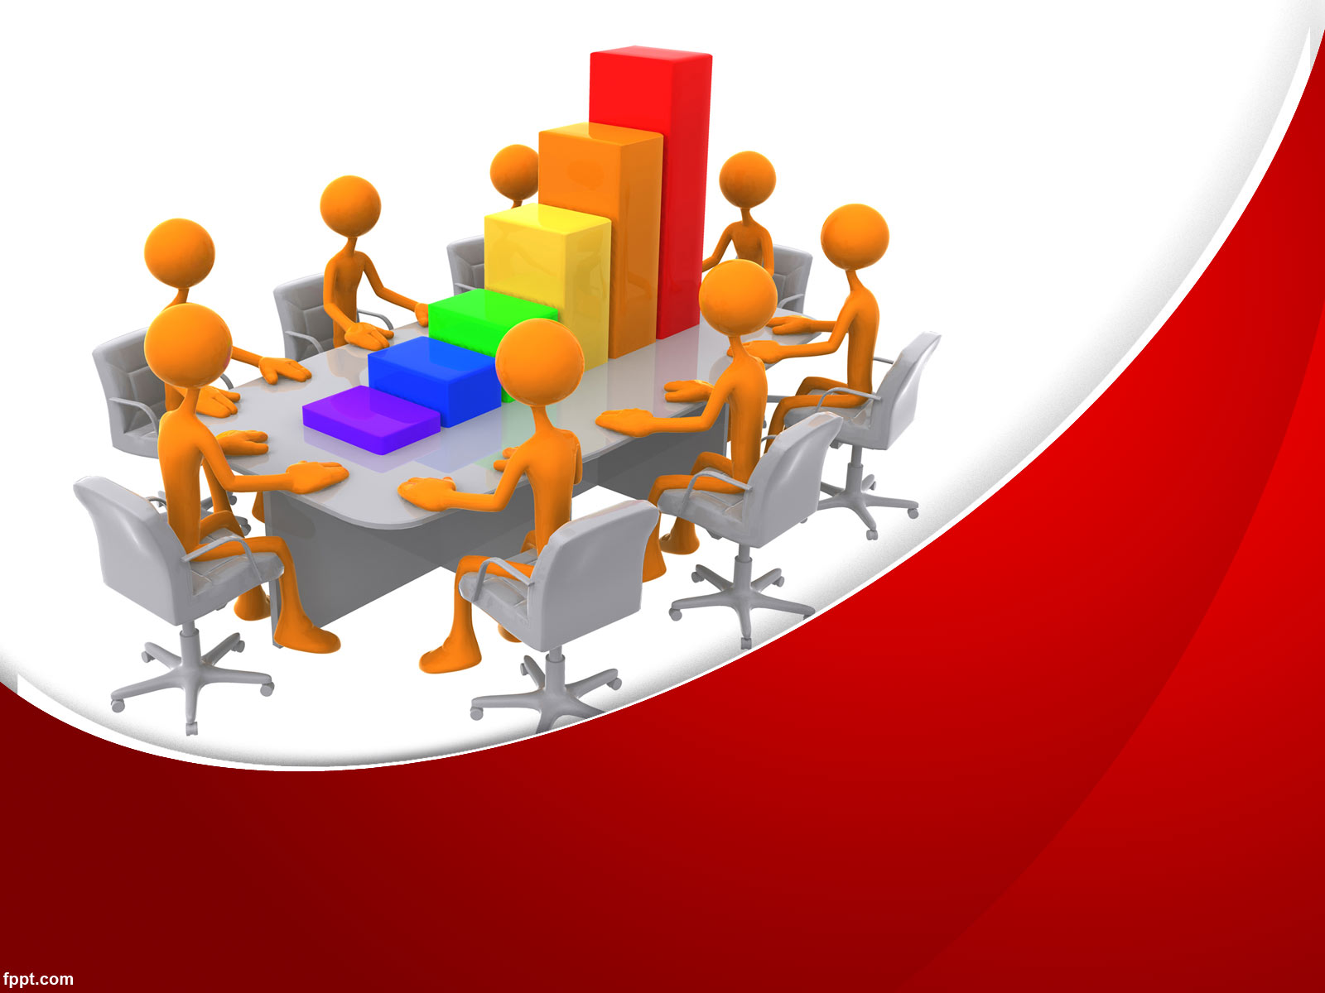
Building Strong Collaborative Community Efforts
Greg Pliler
Midwest Counterdrug Training Center

Slide 2
Midwest Counterdrug Training Center
Counterdrugtraining.com

Slide 3
Learning Objectives
By the end of this course, you will be capable of;
Identifying the need for collaboration
Identifying a lead agency
Identifying key individuals and organizations
Recruiting & retaining members
Developing structure and rules to promote success
Engaging Community Members
At the end of the day you will have:
2-4 actionable items to achieve (page 5)

Slide 4

Introductions (page 4)
Name
Organization
Number of years in prevention
Number of years working with coalitions
Define “coalition”
What major problems have you identified in coalition work?
Is there anything specific you would like to learn today?

Slide 5
Coalitions Defined (page 6)
A group of individuals representing diverse organizations, factions or constituencies who agree to work together to achieve a common goal. (SAMHSA)

Slide 6
Levels of Collaboration (page 7)
Networking
Cooperating
Coordinating
Full Collaboration
Notes:
Hogue, 1993; Borden & Perkins, 1998, 1999
Frey, B.B., Lohmeier, J.H., Lee, S.W., & Tollefson, N. (2006). Measuring collaboration among grant partners. American Journal of Evaluation, 27, 3, 383-392
Collaboration is generally treated as meaning the cooperative way that two or more entities work together towards a shared goal. The School Program Evaluation and Research Team developed the Levels of Collaboration scale, based on the work of other collaboration researchers (Hogue, 1993; Borden & Perkins, 1998, 1999) to measure progress over the five stages of collaboration. The five stages are described as:
1. Networking-Aware of organization
-Loosely defined roles
-Little communication
-All decisions are made independently
2. Cooperation-Provide information to each other
-Somewhat defined roles
-Formal communication
-All decisions are made independently
3. Coordination-Share information and resources
-Defined roles
-Frequent communication
-Some shared decision making
4. Coalition -Share ideas
-Share resources
-Frequent and prioritized communication
-All members have a vote in decision making
5. Collaboration-Members belong to one system
-Frequent communication is characterized by mutual trust
-Consensus is reached on all decisions
It is also possible that some partner groups have no interaction with other groups, especially at baseline, and this possibility is reflected in the instrumentation by allowing respondents to choose “0” to indicate no collaboration whatsoever.
Given the definitions of each level, during administration of the scale, respondents are asked to what extent they collaborate with each other grant partner. Answer options are on a 0 to 5 scale with 0 indicating “no interaction at all” and 5 indicating the collaboration level using Hogue’s taxonomy.
Data collected with the Levels of Collaboration scale can be reported quantitatively utilizing different formats and different summations depending on the interests of evaluators, grant directors and stakeholders. Collaboration can be reported as the mean level of perceived collaboration across all respondents for all partners, summarized in other meaningful ways, or provided as raw data in a table. Because, by definition, collaboration only exists when two or more parties interact with each other, situations where two partners report different levels of collaboration with each other represent areas for exploration and discussion between those partners. As the scale assesses perceptions of collaboration, different perceptions by two collaborating partners may both be valid responses.
CAPT – Levels of Collaboration- Understanding the Basics
There are many different ways for stakeholders to work together. Collaboration between partners can range from informal (e.g., two agencies sharing information) to much more organized (e.g., multiple organizations working closely to achieve a shared vision). The following chart describes four levels of collaboration: networking, cooperation, coordination, and full collaboration. We suggest using the chart to determine your current level of involvement with a partner, as well as options for deepening this relationship over time. You can also use the chart to explore different options for collaborating with new partners. Please note that no single type of collaboration is “better” than another. The best type is the one that is the best fit, given what you and your partners hope to achieve.

Slide 7
Collaboration
Activity
(page 8)

Slide 8
BREAK – 10 minutes

Slide 9
Identifying the need for collaboration
Should we start a coalition to address the issue in the community?
Is it the right time to start a coalition?

Slide 10
Should we start a new coalition?
Is a Coalition Right for You?
Questionnaire
(page 9)

Slide 11
Lead Agencies (page 10)
Strong links to and respect for the local community
Has respect of community organizations and key leaders and perception as neutral entity
Understanding of community health issues, priority populations, and local politics
Adoption within its own walls of positive health practices that support the activities of the coalition
Butterfoss, F. D. (2007). Coalitions and partnerships in community health. San Francisco, CA: Jossey-Bass.

Slide 12
Lead Agencies
Ability to serve as an umbrella organization (501(c)(3))
“Deep Pockets” or at least a reserve of resources to support the basic administrative needs of the coalition
Staff support through employment and benefits structure
Development, media, and advocacy capabilities to promote the coalition
Butterfoss, F. D. (2007). Coalitions and partnerships in community health. San Francisco, CA: Jossey-Bass.

Slide 13
Is my organization suited to be a lead agency?
Who else in my community could or should be a lead agency?

Slide 14
Key Individuals and Organizations (page 11)
Leaders
Administrative & Facilitators
Champions
Technical Experts
Evaluation Experts
Community Experts
The problem
12 sectors

Slide 15
Key Individuals and Organizations
Leaders
Empowering
Works effectively with staff
Assertive
Information sharing
Encourages ideas and participation
Open minded
Effective communicator

Slide 16
Key Individuals and Organizations
Administrative & Facilitators
Assertive
Must be willing to “let go”
Capable of coaching
Detail oriented
Multi-tasker
Capable of dealing with difficult
personalities

Slide 17
Key Individuals and Organizations
Champions
Passionate about the cause
Don’t take no for an answer
Can effectively communicate (charismatic)
Basic understanding of the issue
Must be able to be “reigned in”

Slide 18
Key Individuals and Organizations
Technical Experts
Strong understanding and experience in prevention and community change
Willing to dedicate time and be available
Unbiased, upfront
Education in the field

Slide 19
Key Individuals and Organizations
Evaluation Experts
Experience evaluating community change
Experience evaluating individual and environmental strategies
Willing to build evaluation skills among coalition members
Local?

Slide 20
Key Individuals and Organizations
Community Experts
Someone who knows your community
Has a history with the community
Knows who is important and how decisions are made
Knows the informal and formal leaders

Slide 21
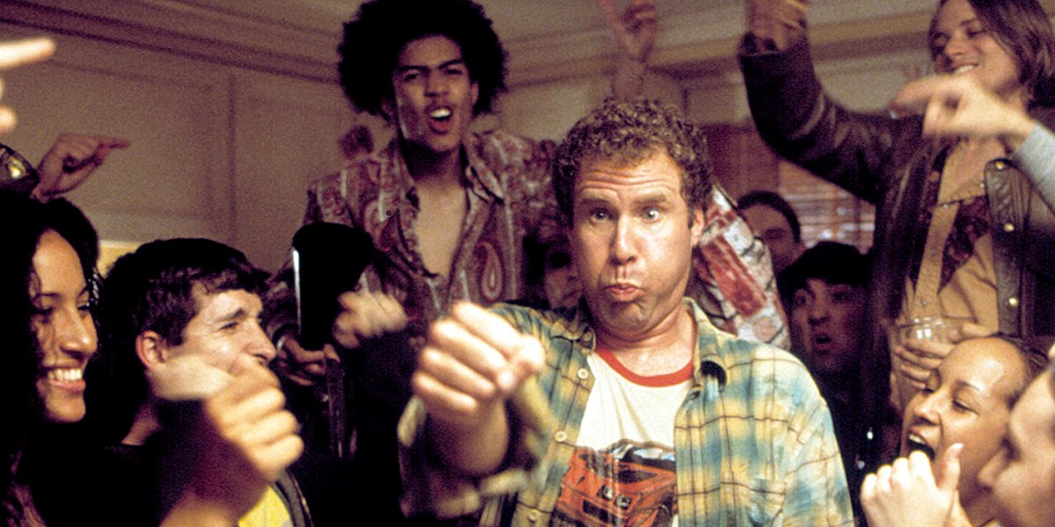
Key Individuals and Organizations
The problem

Slide 22
BREAK – 10 minutes

Slide 23
Key Individuals and Organizations (page 12)
12 Sectors
Youth and Young Adult
Parent
Business
Media
School
Youth Serving Organization
Law Enforcement
Religious/Fraternal Organization
Civic/Volunteer Group
Healthcare Professional
State/Local/Tribal government
Other SA
Colorado Office of Behavioral Health (2015) Strategic Prevention Framework-Partnership for Success (SPF-PFS) Tookit 2015-2020. Retrieved from http://www.omniportal.org/BHPACDocuments/Substance%20Use%20Prevention%20Strategic%20Prevention%20Framework%202015-2020.pdf

Slide 24
Recruiting and retaining members (page 13)
Assess member and resource needs
Develop a long term strategy
Make a plan
Execute

Slide 25
Assessing the need for new membership
(page 13)
Identify the resources the coalition already has
  Are the resources truly known?
  Are they used?
Identify what is needed
  Skills
  Sectors
  Resources

Slide 26
Activity (page 14)
Think about the coalition you support or a coalition you would like to start
Name three resources, sectors, or skills necessary for success
Use the Coalition Needs Brainstorming Tool to identify resources

Slide 27
Retaining Members (page 15)
Recognition
Respect
Role
Relationship
Reward
Results

Slide 28
Activity (page 15)
Brainstorm one activity your coalition can do to retain members for each “R” (6 total)
With a partner, share your ideas. Identify the best idea for each “R”. Place them on a sticky note
Place your sticky notes on the correct area on the wall

Slide 29
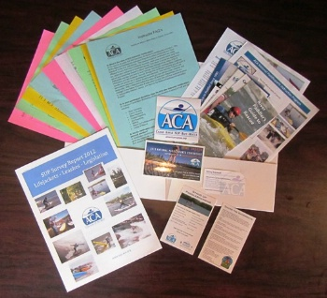
New member packets
(page 16)
A new member packet is a packet of coalition materials given to new member that informs them about the coalition.
At a minimum it should include:
Commitment Letter
CBO History
Community data
New Member Questionnaire

Slide 30
New Member Packet
Other item may include:
Welcome Letter
Mission and Vision
Skill and Interest Questionnaire
Bylaws, policies, member expectation
CBO Calendar
Past Events
CBO Partners
Committees and Workgroups
Most recent meeting minutes
List of Board Members

Slide 31
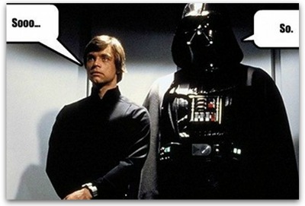
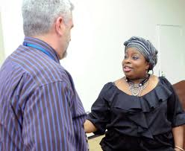
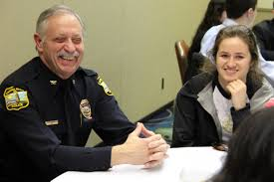
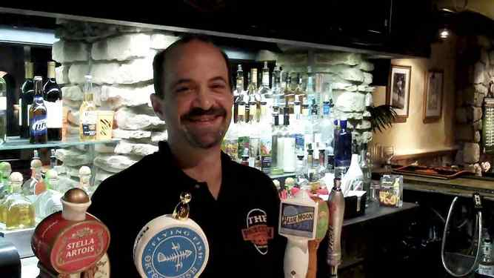
Talking to potential new members (page 17)
Elevator Speech
Focused Conversation

Slide 32
Developing structures and rules (page 18 – 20)
Organizational Structure
  Typically hierarchal with executive committee and subcommittees (permanent and ad-hoc)
  Staff may be placed adjacent or within the hierarchy

Slide 33
Developing structures and rules (page 21)
Bylaws are used to:
Help organizations deal with new situations
Help organizations make decisions
Help organizations operate ethically
Bylaws are:
Formally written rules that control the internal operations of the organization
A document that formally defines the groups:
Official name
Purpose
Requirements for membership
Officer titles and responsibilities
How officers are assigned
How meetings are conducted
How decisions are made
Bylaws serve as the legal guidelines of an organization and the organization COULD BE CHALLENGED in court for its actions if it violates them

Slide 34
Developing structures and rules (page 22)
Job Descriptions;
Define the position for the organization and potential applicants
Clarify duties
Make it clear when a member is not performing to standard
Will make it more likely that you will find the right person for the job

Slide 35
Developing structures and rules
Job Descriptions have;
Title
Duties
Length of service in the position
Time needed
Background required (skills, education)
Reporting structure
Paid/Volunteer

Slide 36
Engaging community members page 23
Be inclusive (Don’t just invite friends)
Define useful roles
Don’t meet for the sake of meeting!
Rotate meeting locations and times
Change format (informal, calls, surveys, independent work groups)
Use electronic media effectively
http://www.healthypeople.gov/2010/state/toolkit/08Partners2002.pdf

